Slide 1
Task 1 Update
Peter Sharpe & Jonathan Richter
Harvard-MIT Center for Advanced Climate Research

Slide 2
Welcome Jonathan!
And happy belated birthday! (Friday?)

Slide 3
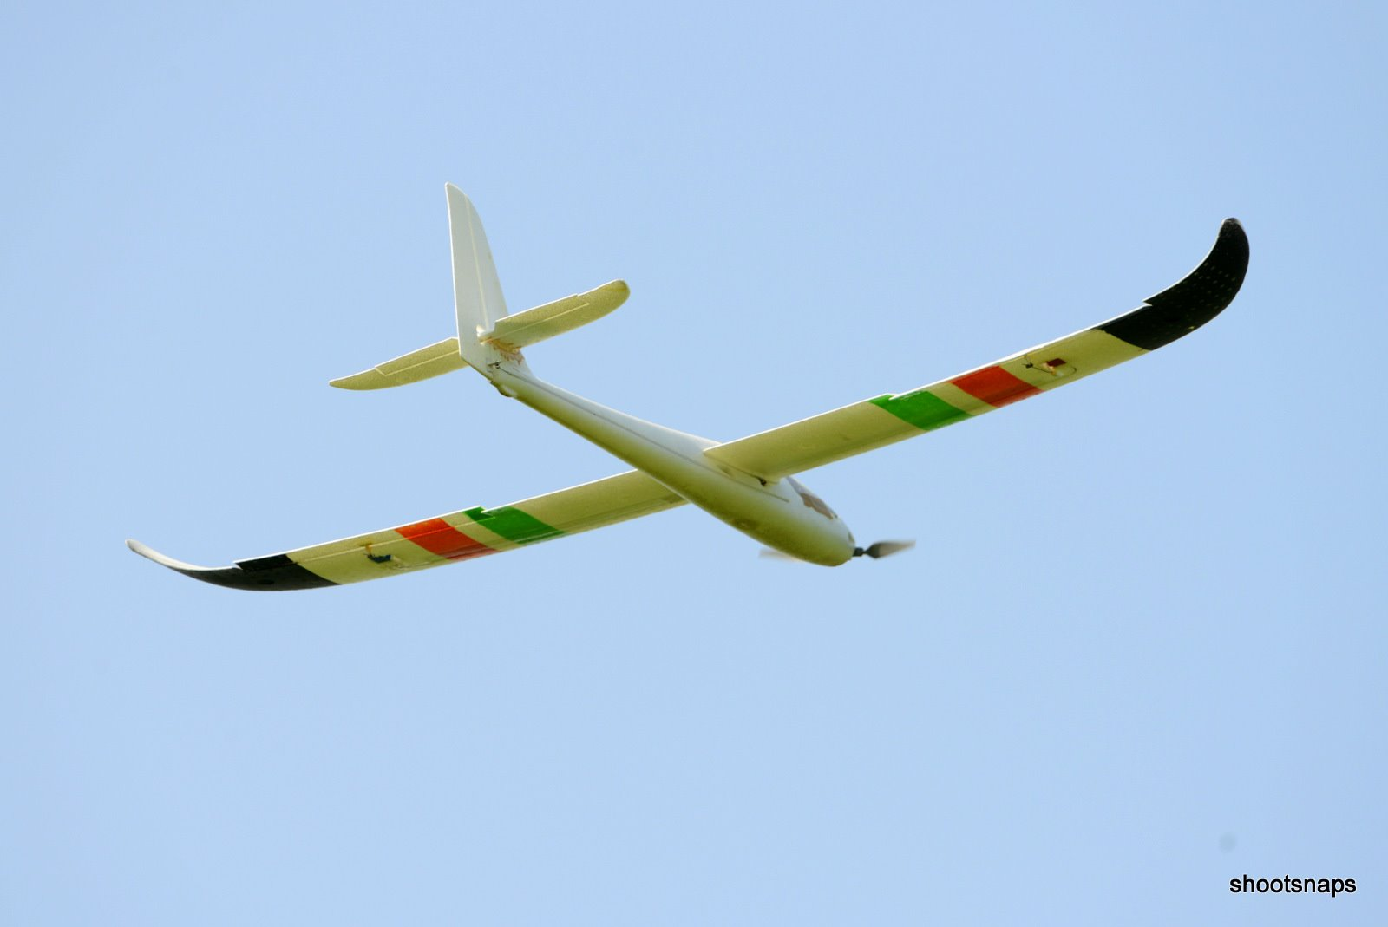
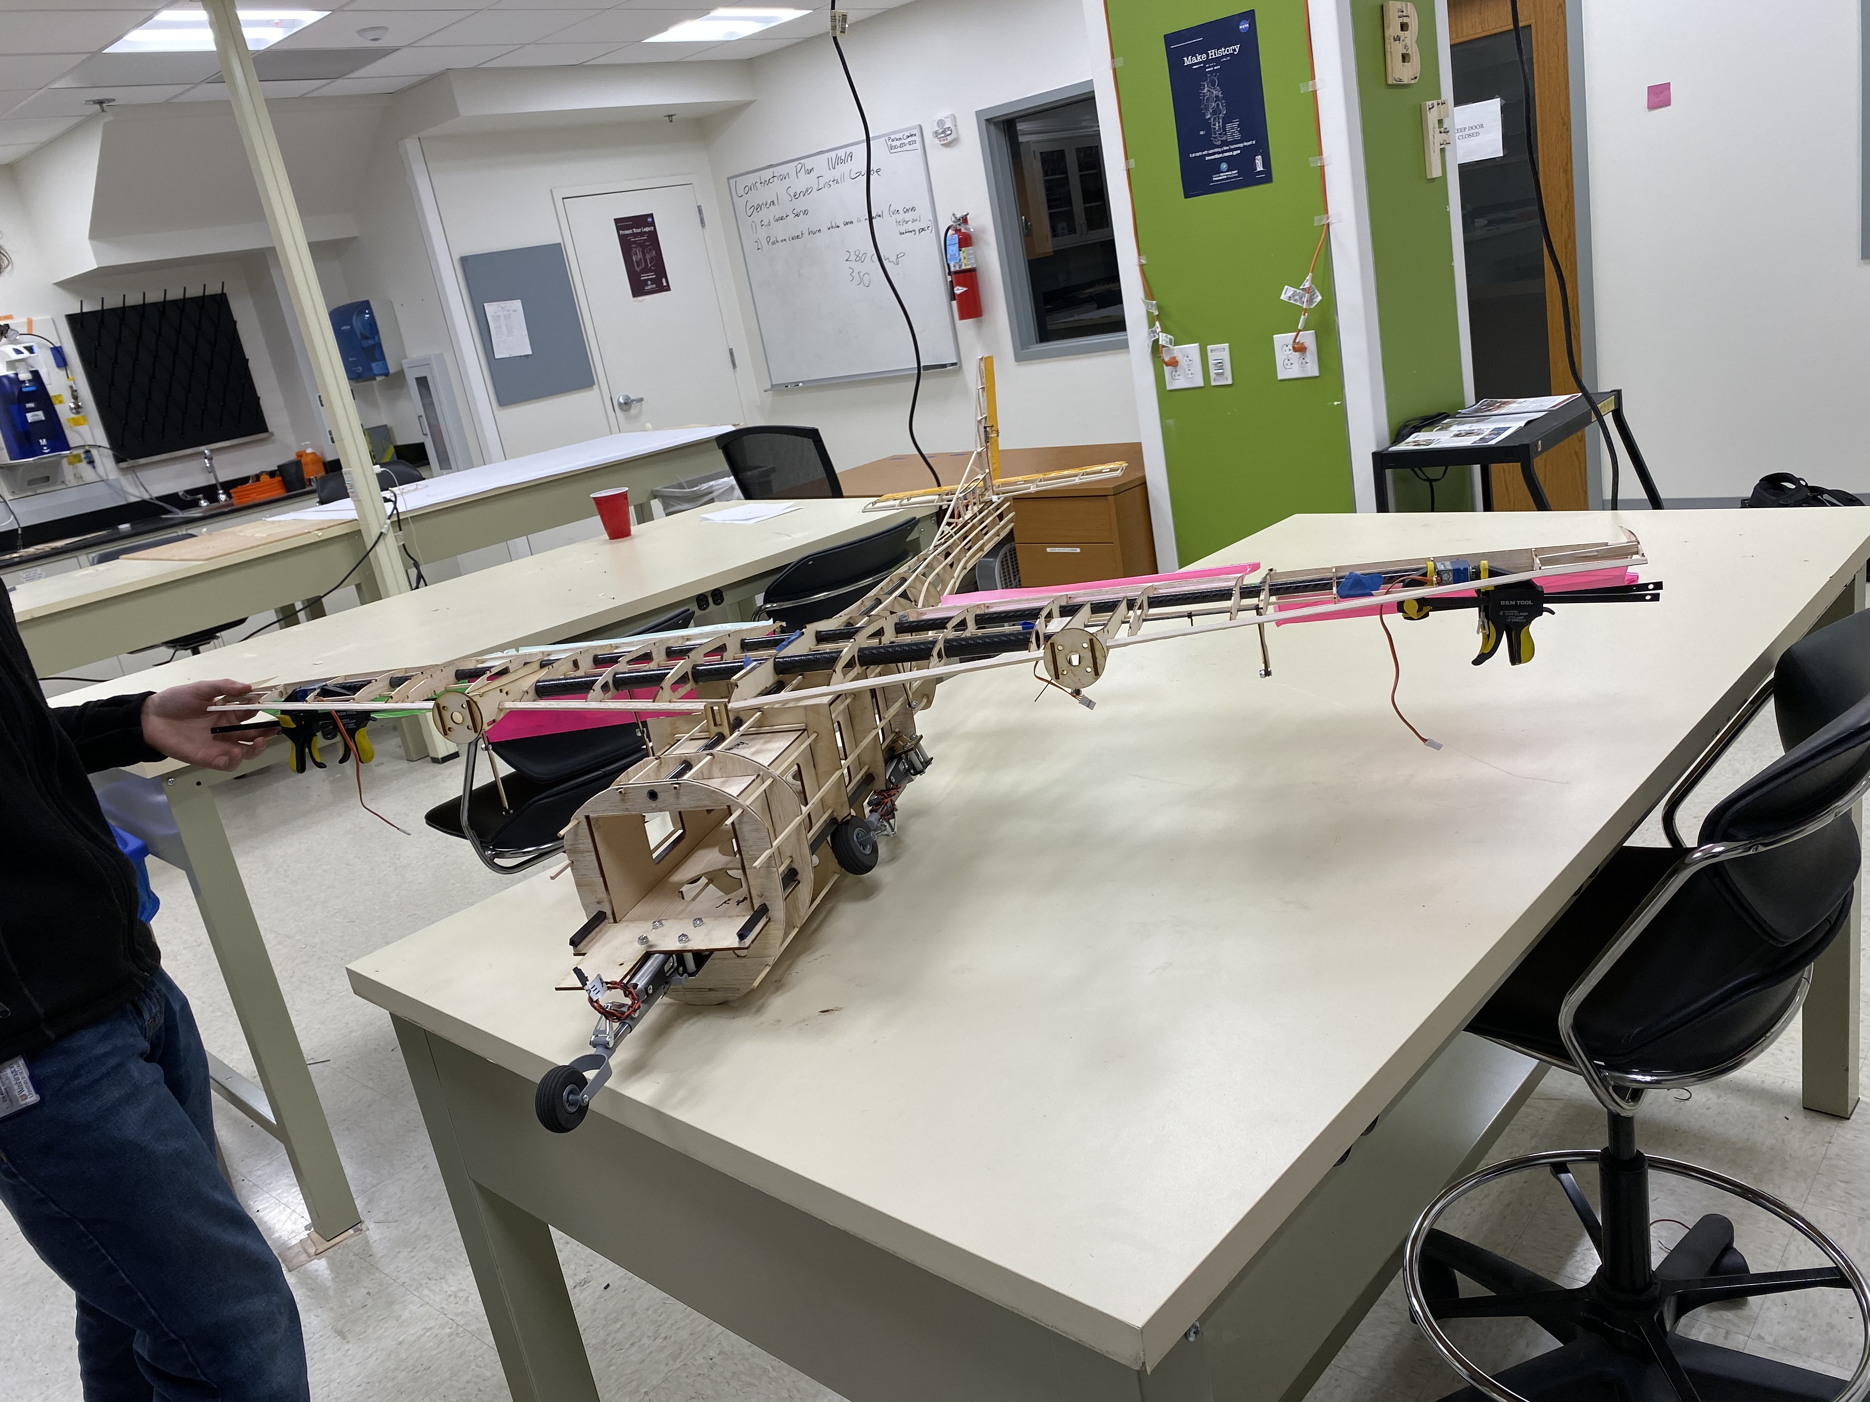

New Intern: Jonathan Richter
Washington University in St. Louis Class of 2021
BS Mechanical Engineering Minor Aerospace Engineering
WashU Design Build Fly Chief Engineer 2019-2020
Poor Man’s Pilot: 15 years of RC experience
Currently Located: Stamford, CT (~45 mi NYC)

Slide 4
Battery Modelling

Slide 5
Updates from Kevin Uleck

Slide 6
Study #1: One Big Vertical Stabilizer

Slide 7
Options
Equal Vertical Stabilizers
Single Center Vertical Stabilizer

Slide 8
Graphics for Pitches

